Slide 1
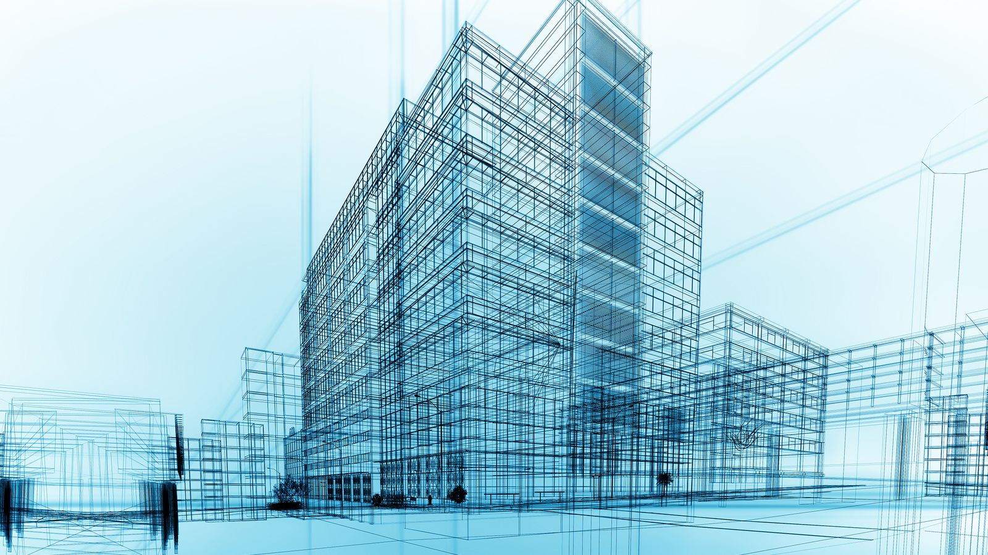
STRUCTURAL
ENGINEERING
Res.Assist.Aysu GÖÇÜGENCİ
MSKU Civil Engineering Department

Slide 2
CONTENT
Sub-disciplines
Definition
Main Goal/Design Criteria
Progress of SE
Structure Types
Steps to Follow in Road to Goal
Fields of Specialty
Necessary Terms
Structural Failures
MSKU Civil Engineering Department

Slide 3
SUB-DISCIPLINES of CE
Structural Engineering
Earthquake Engineering
Geotechnical Engineering
Materials of Construction
Transportation Engineering
Hydraulics
Water Resources Engineering
Coastal Engineering
Construction Management
MSKU Civil Engineering Department

Slide 4
DEFINITION
STRUCTURAL DESIGN
+
STRUCTURAL ANALYSIS
=
STRUCTURES THAT CAN
SUPPORT OR RESIST LOADS
MSKU Civil Engineering Department

Slide 5
MAIN GOAL
Structures designed must;
Be safe to its users
Have efficient strength and stiffness
Be economical
Satisfy desired performance.
MSKU Civil Engineering Department

Slide 6
DESIGN CRITERIAS
Safety/Strength/Stiffness/Durability
Economy/Efficient use of funds
Serviceability/Performance/Functionality
MSKU Civil Engineering Department

Slide 7

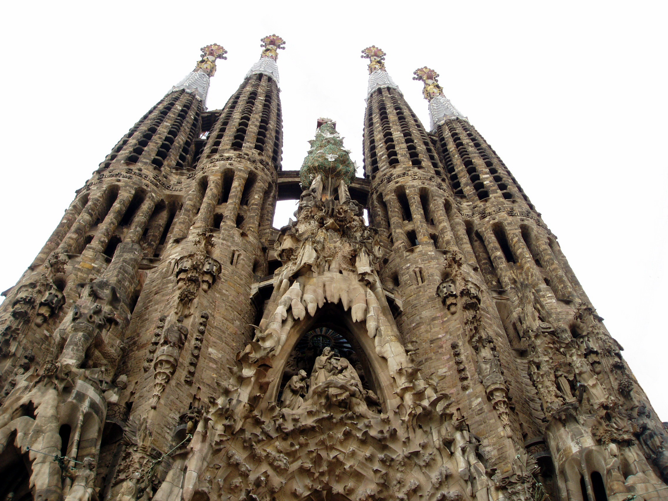
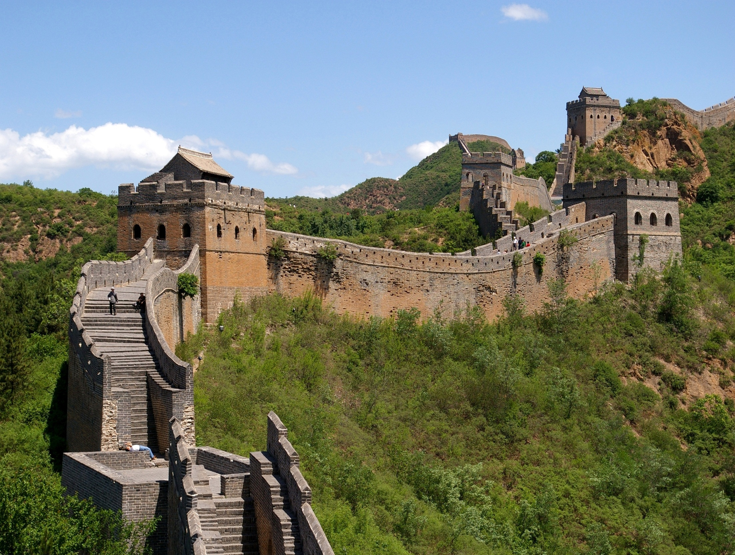
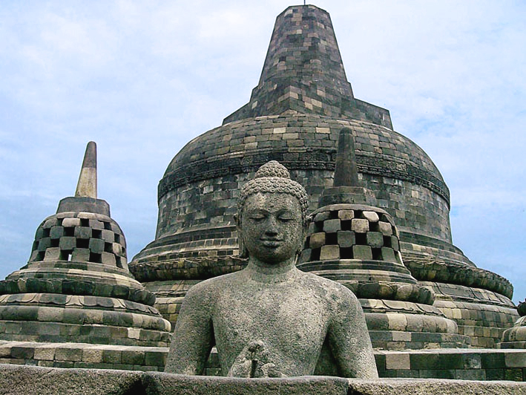
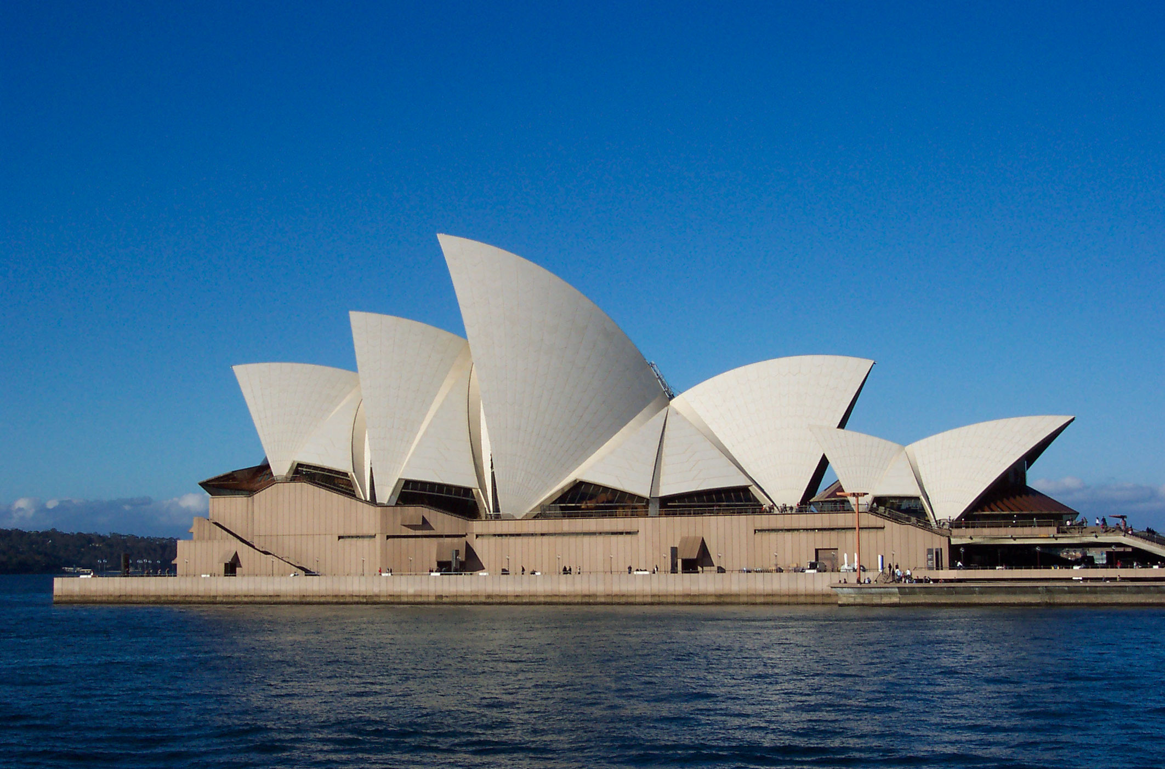

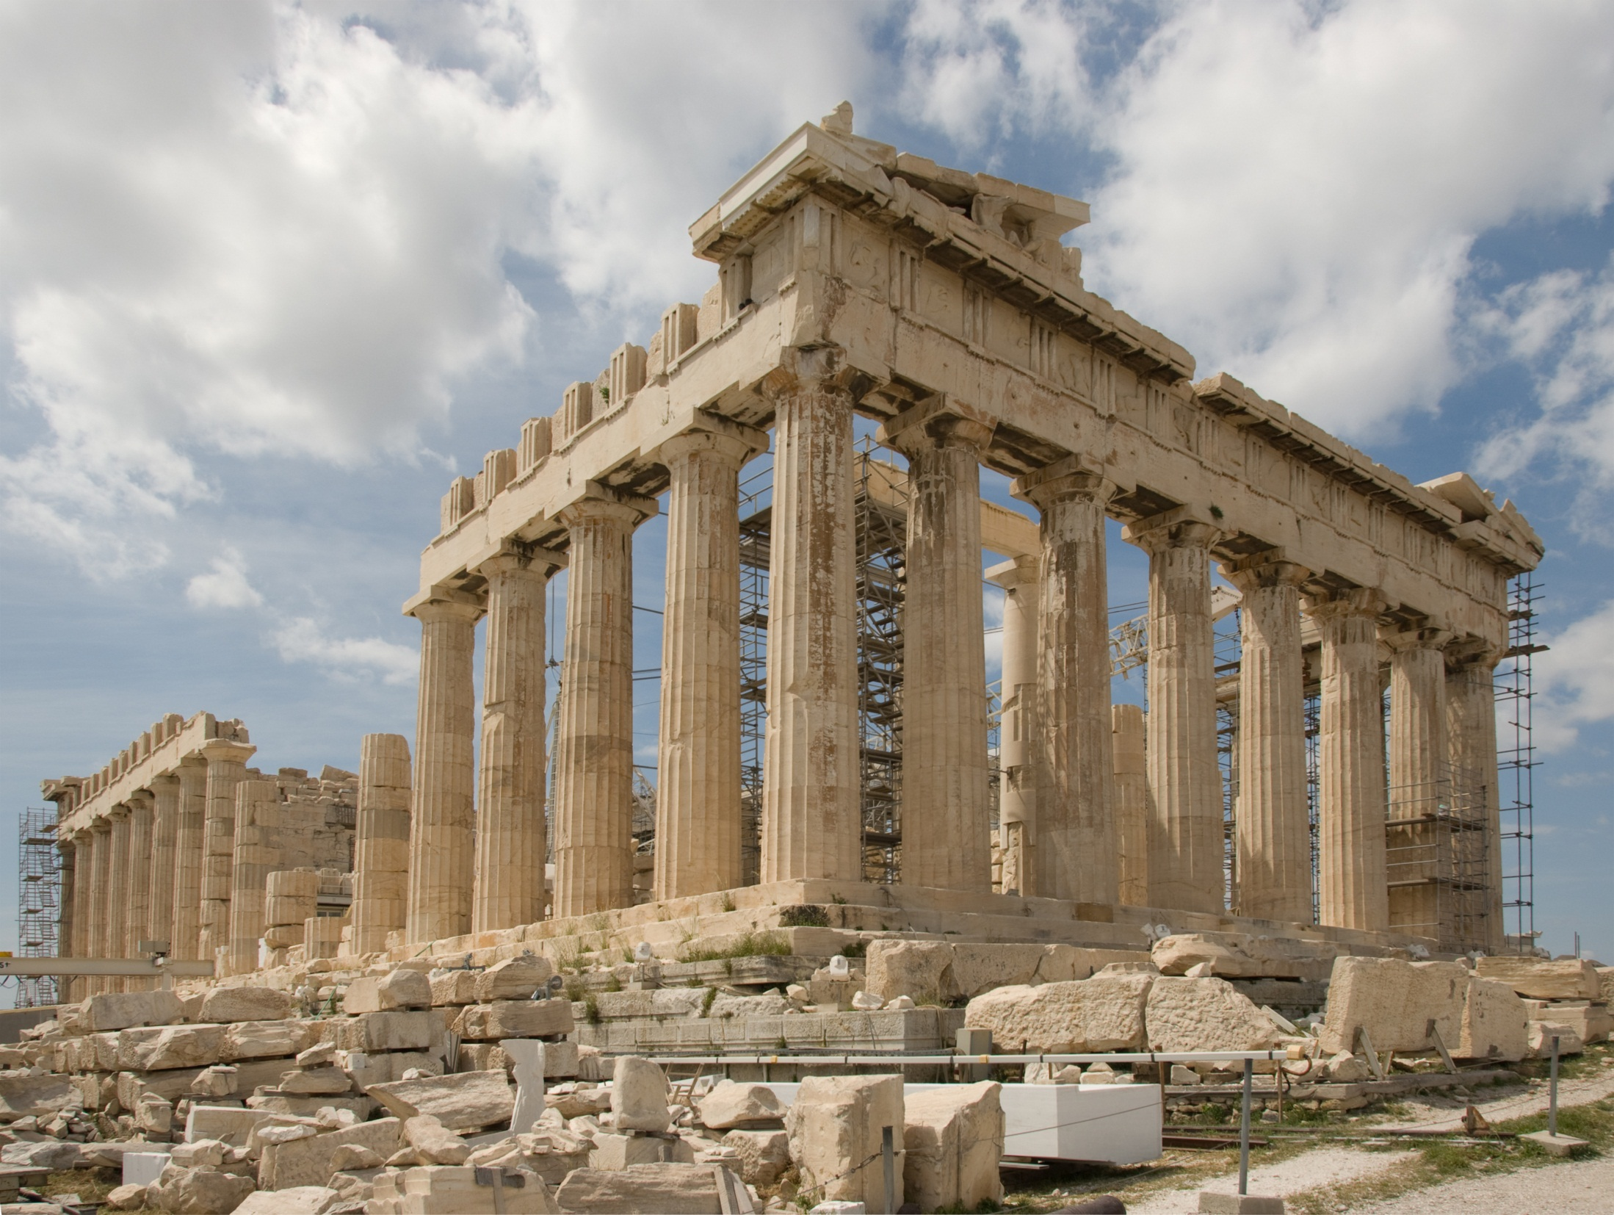
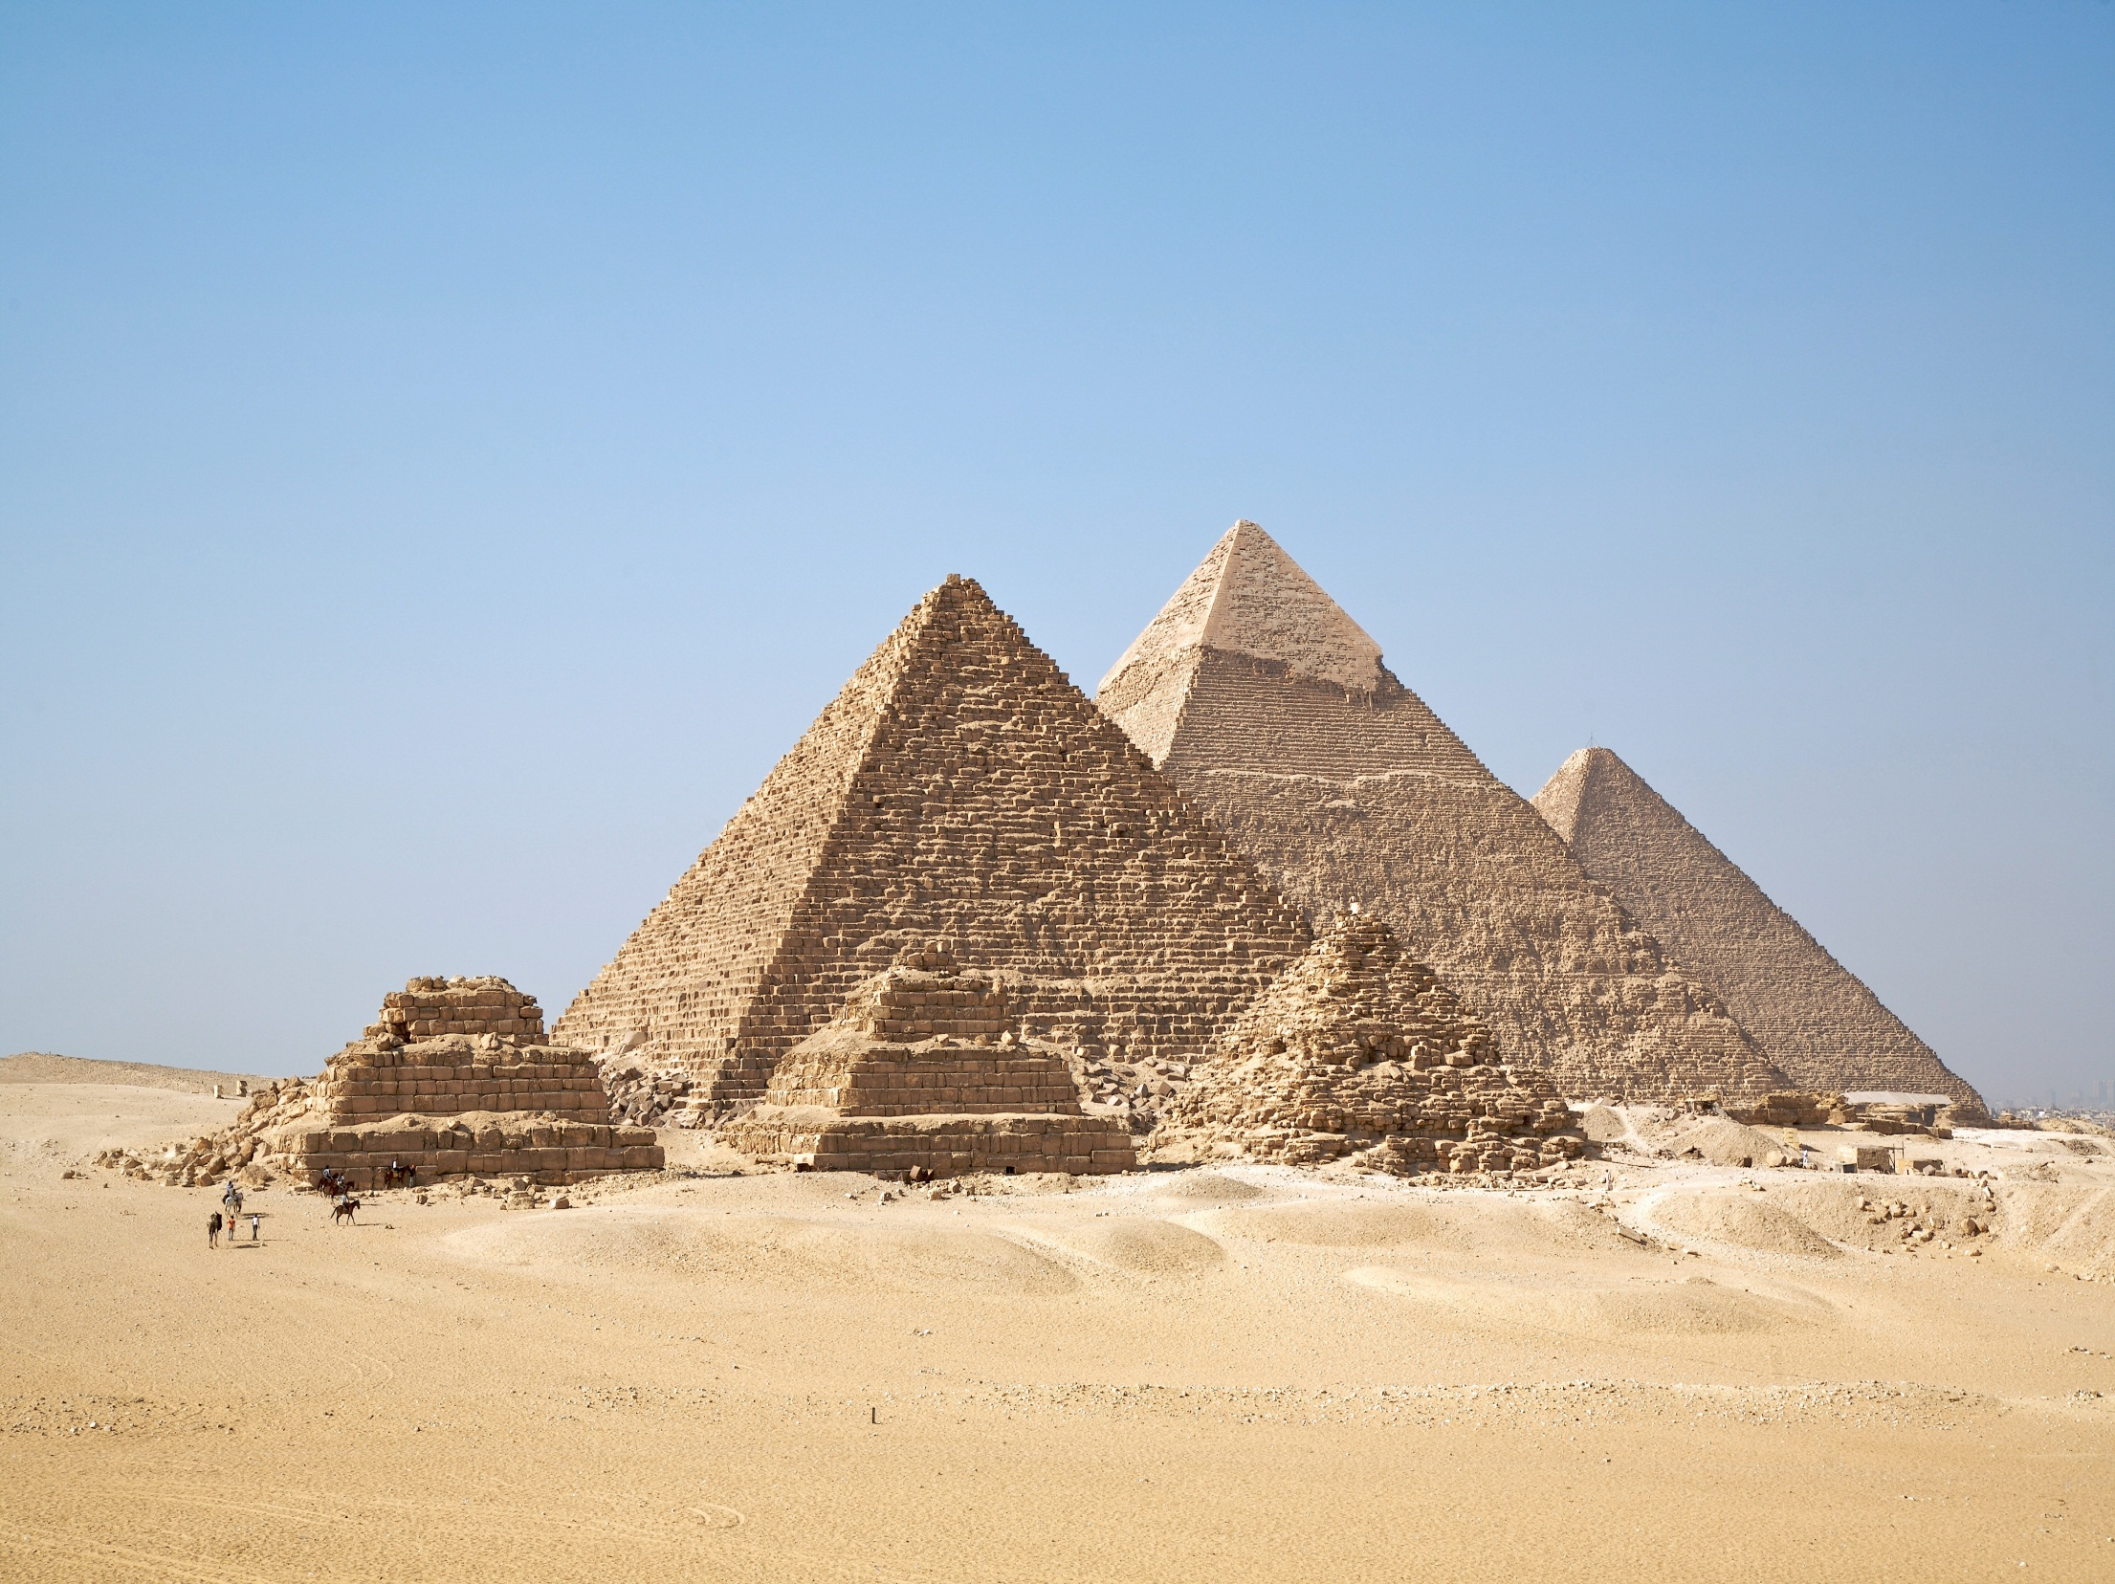
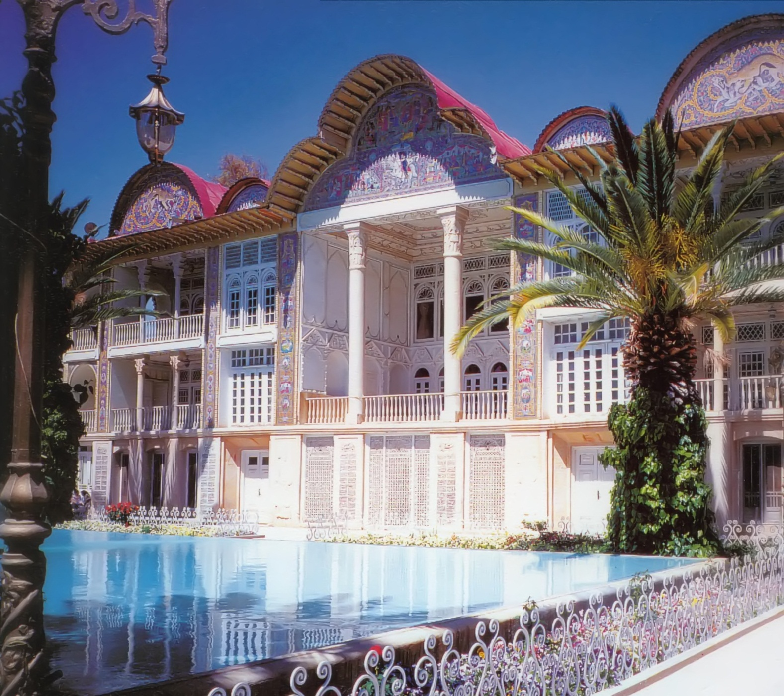
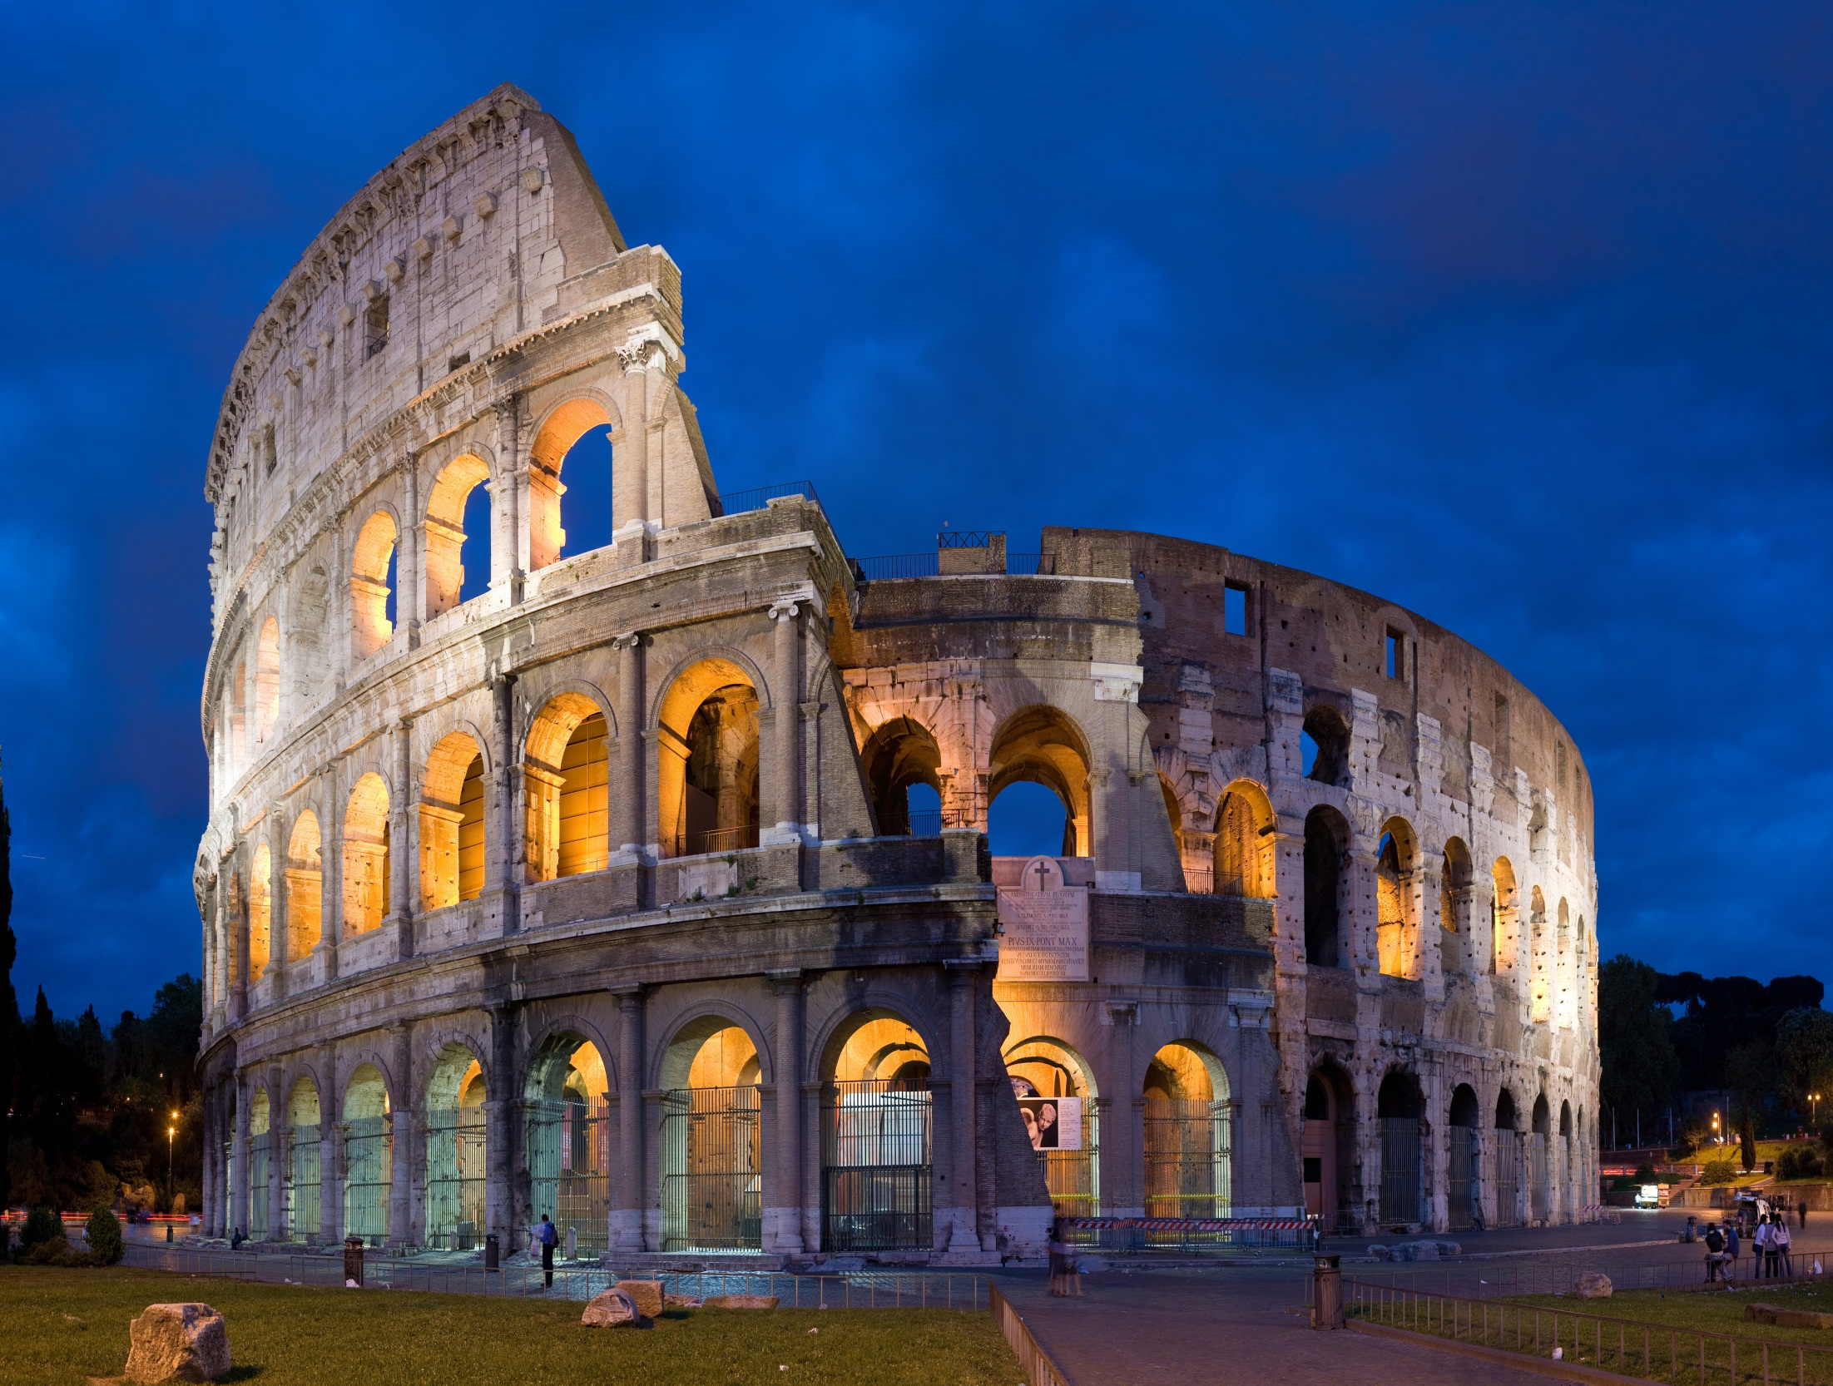
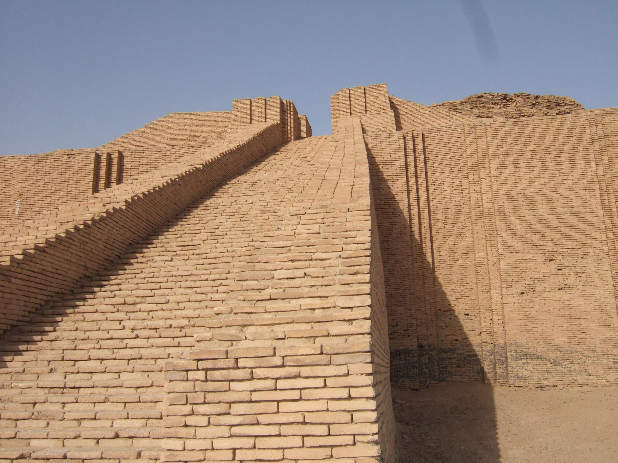
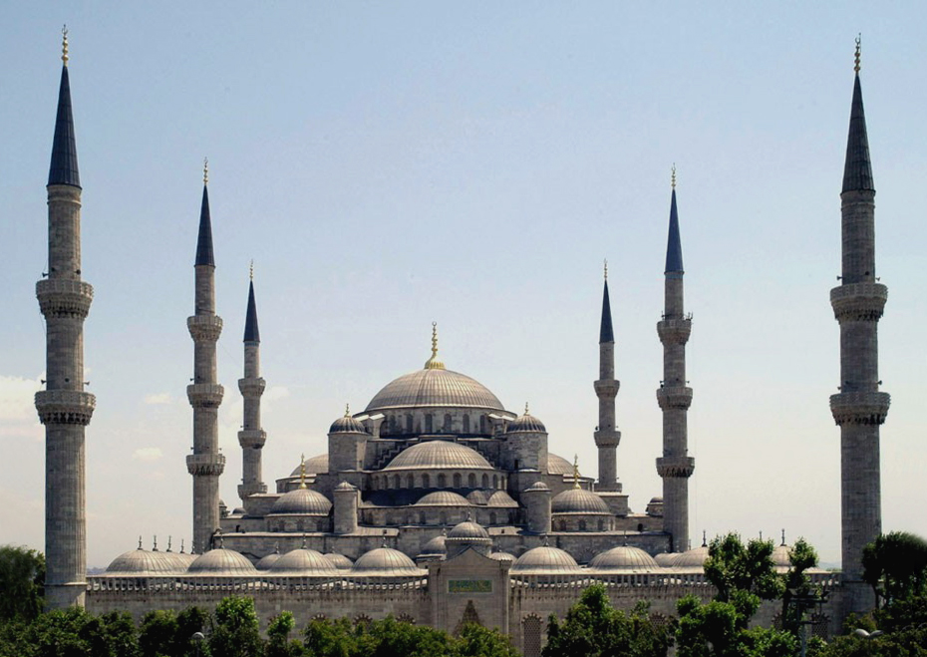
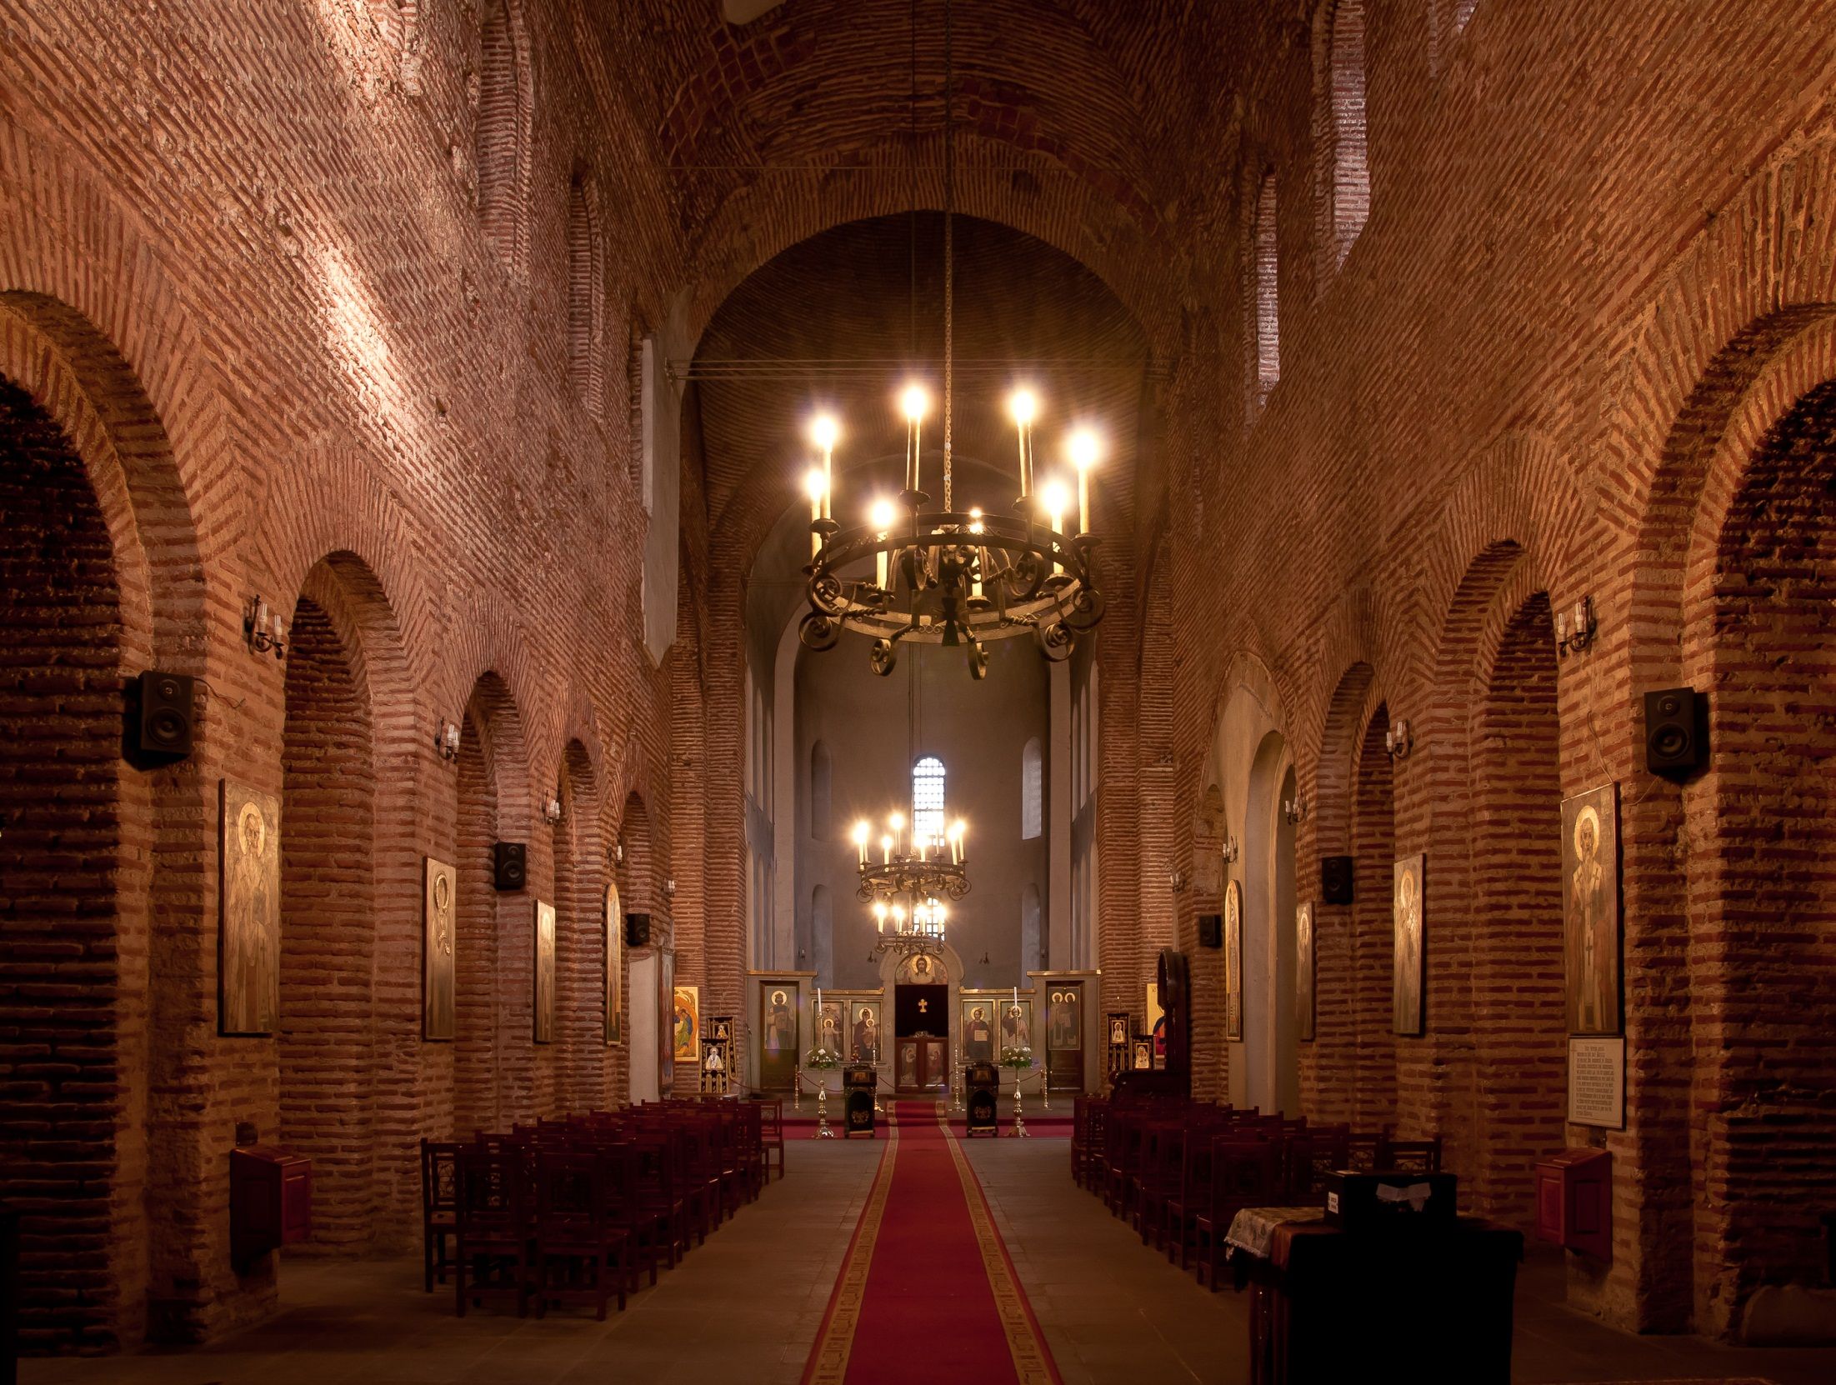
PROGRESS of SE
Ancient Mesopotamia
Ancient Egyptian
Ancient Greek
Roman
Byzantine
Persian
Islamic
Indian
Buddhist
Chinese
Gothic
Renaissance
Modern
MSKU Civil Engineering Department

Slide 8
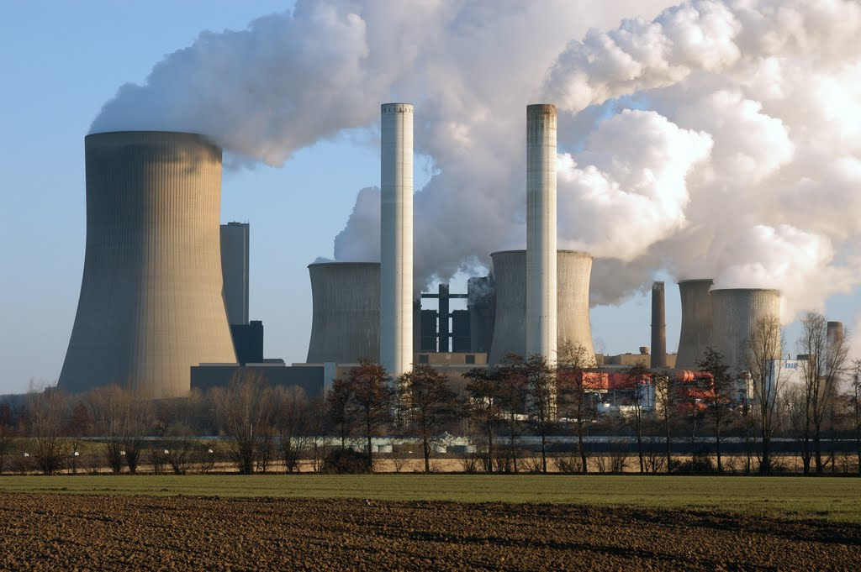
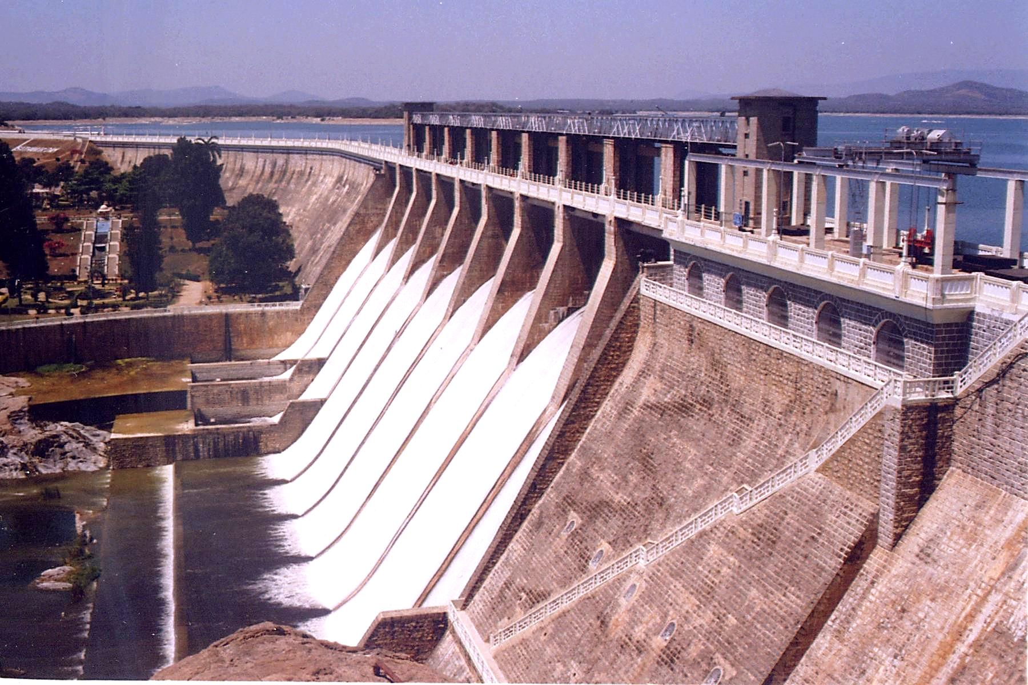
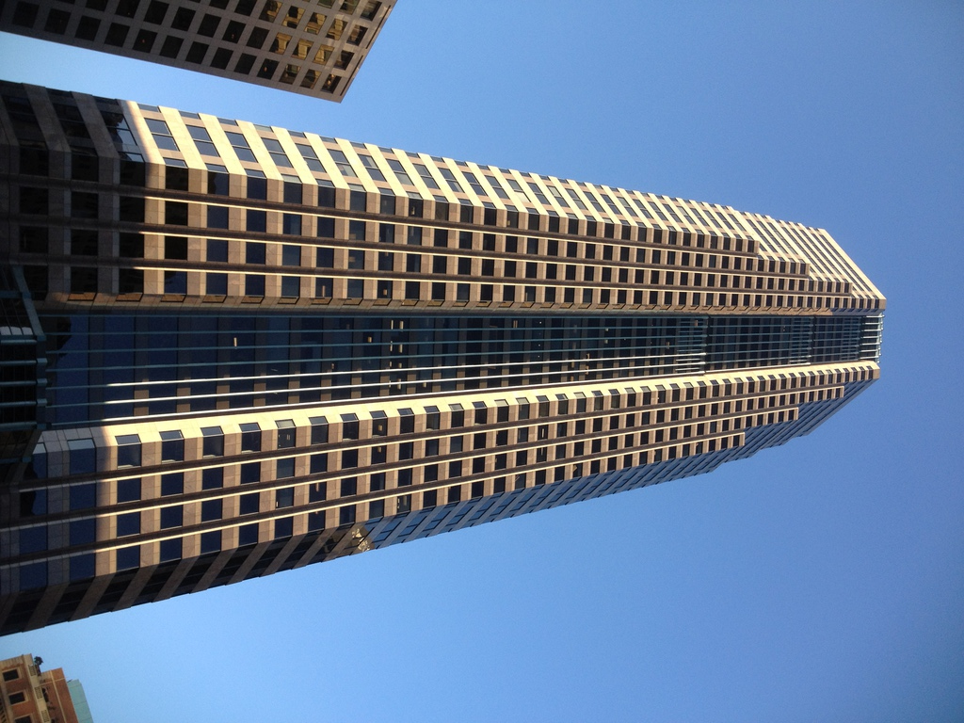
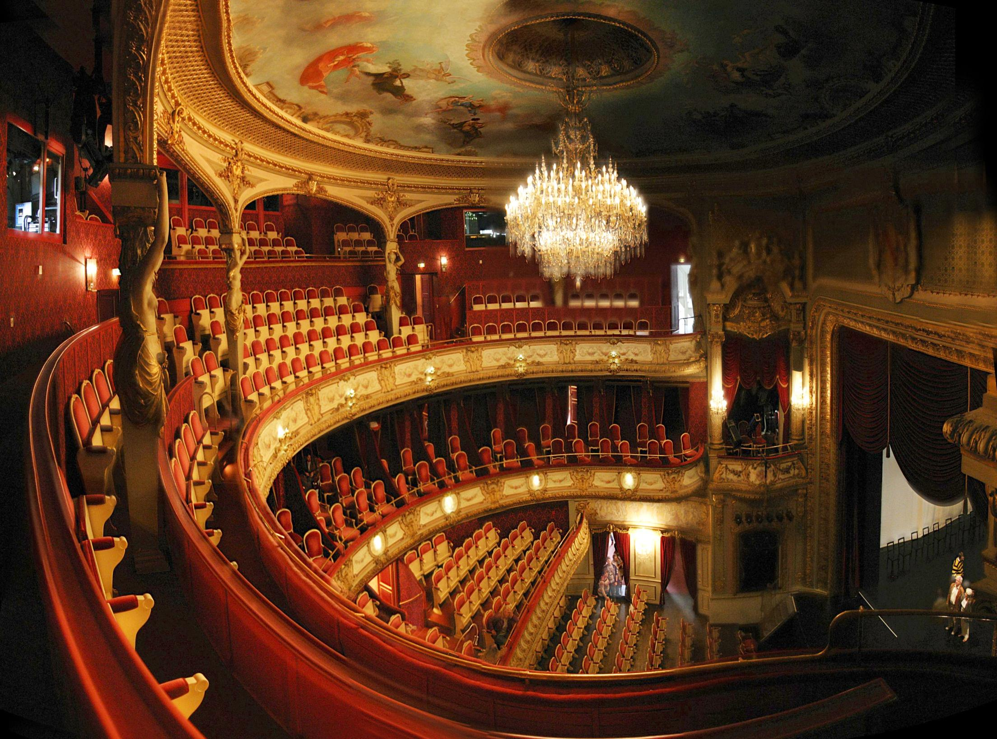
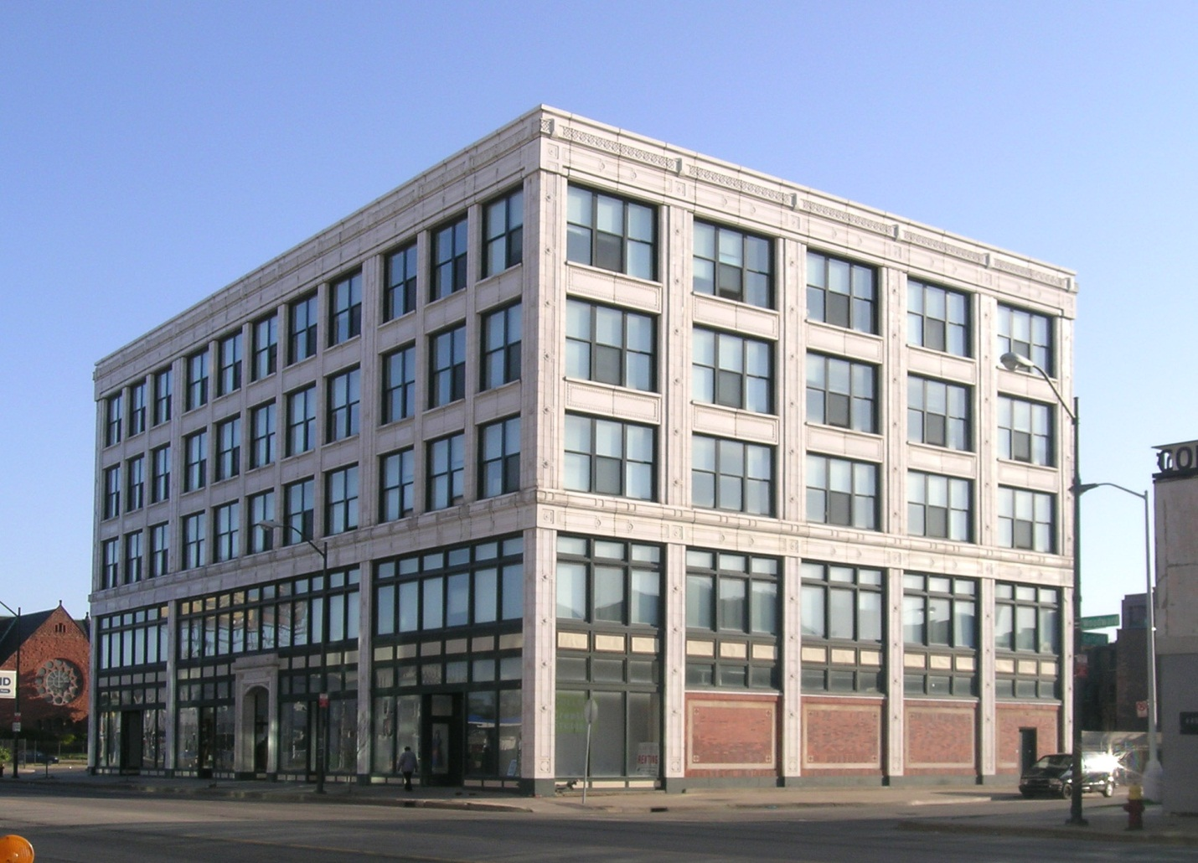
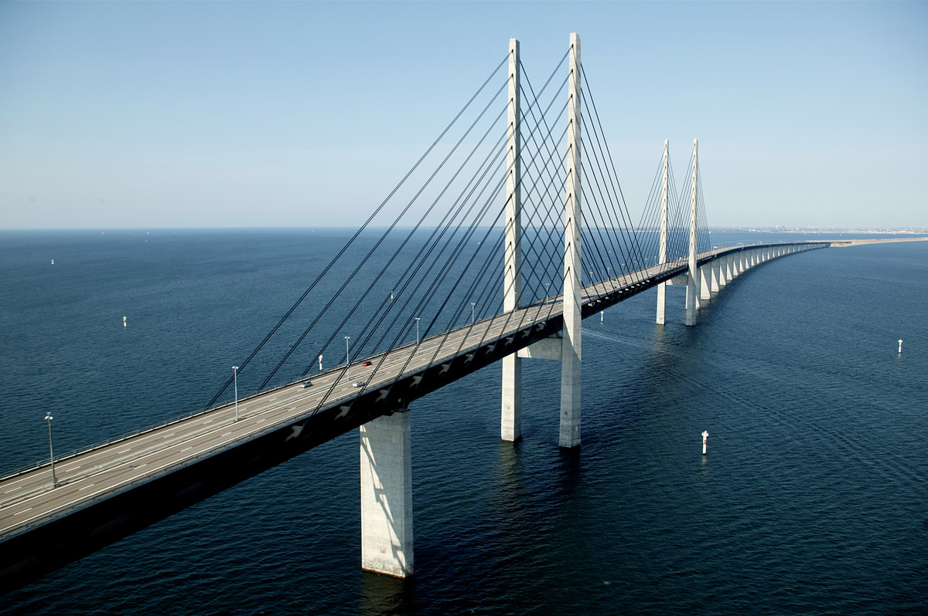
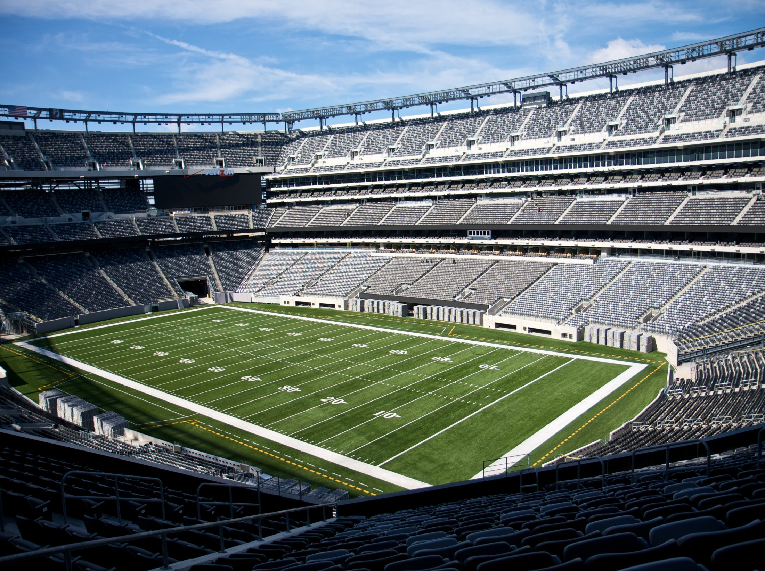
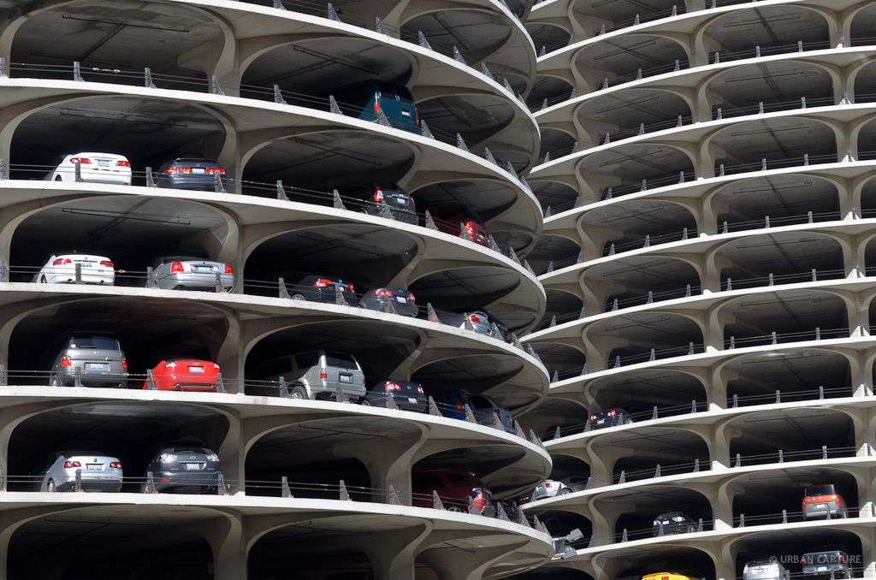
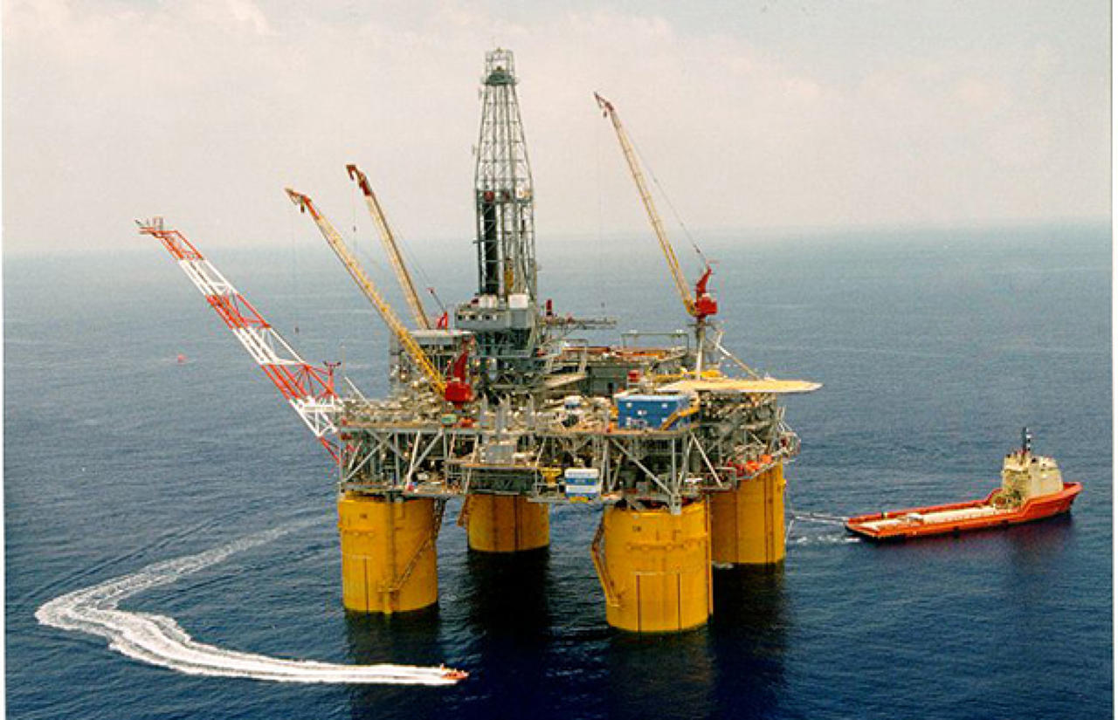
STRUCTURE TYPES
Buildings
Bridges
Skyscrapers
Dams
Parking Structures
Stadiums/Arenas
Theaters
Power Stations
Offshore Oil Platforms etc.
MSKU Civil Engineering Department

Slide 9
STEPS TO FOLLOW
Service Purpose of Structure
Materials
Analytical Model
Loads acting/Forces and stresses
Section/Component/System Design
Physical Laws/Empirical Knowledge/Design Codes
Cost of structure
MSKU Civil Engineering Department

Slide 10
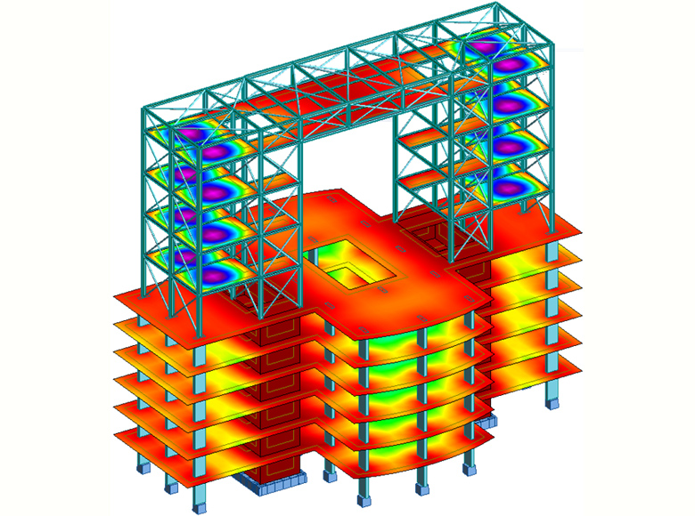
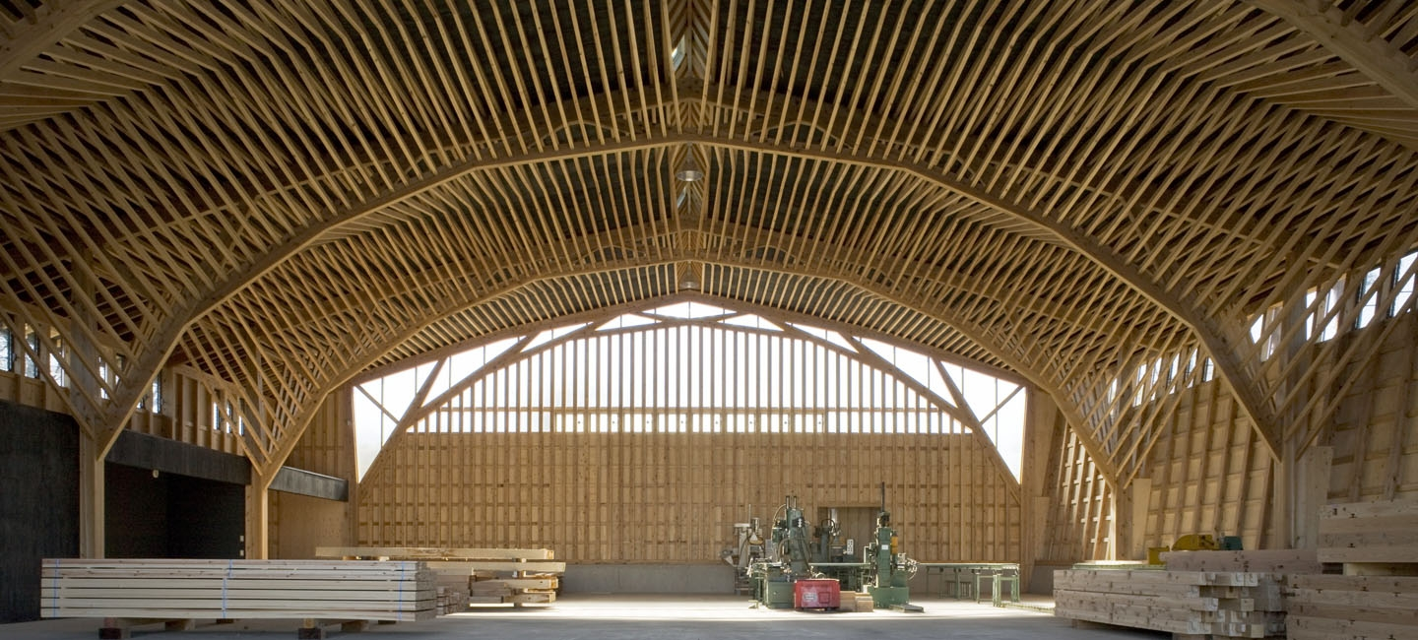
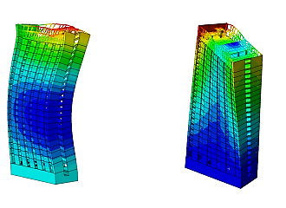
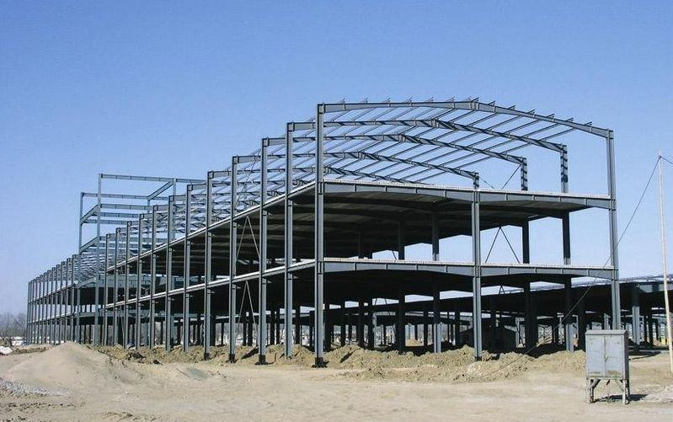
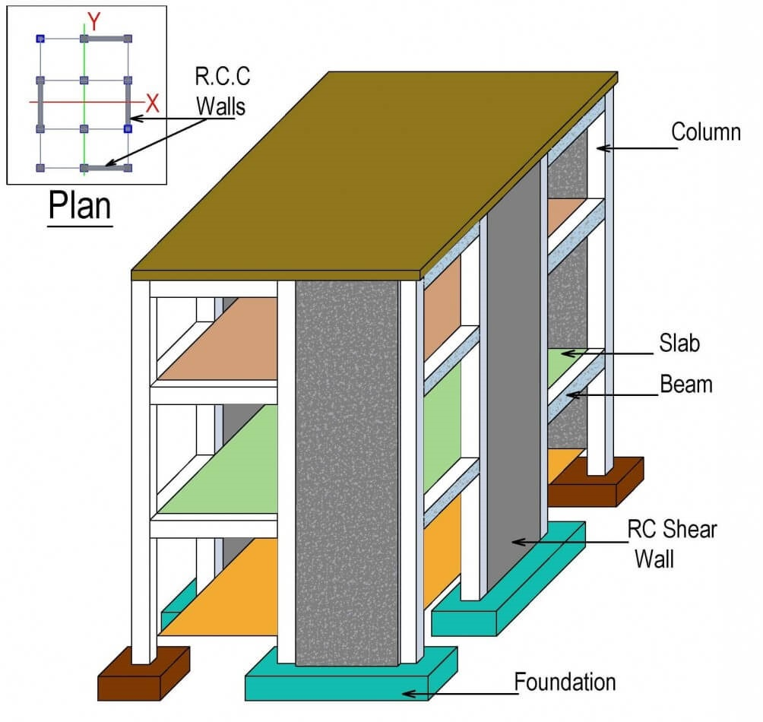
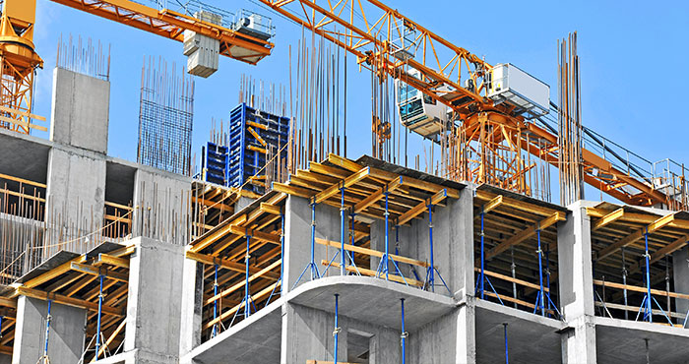
FIELDS OF SPECIALTY
Reinforced Concrete Structures
Steel Structures
Timber Structures
Structural Analysis
Structural Dynamics
MSKU Civil Engineering Department

Slide 11
STRUCTURAL MATERIALS
Concrete=Reinforced/Prestressed
Steel=Hot Rolled/Cold Rolled
Iron=Wrought/Cast
Masonry
Timber=Hardwood/Softwood
Aluminium
Composite Materials=Plywood
MSKU Civil Engineering Department

Slide 12
LOADS ACTING
Self-weight Loads
Other Dead Loads
Live Loads
Moving Loads(Crowd/Vehicle)
Wind Loads
Earthquake Loads
Snow Loads
MSKU Civil Engineering Department

Slide 13
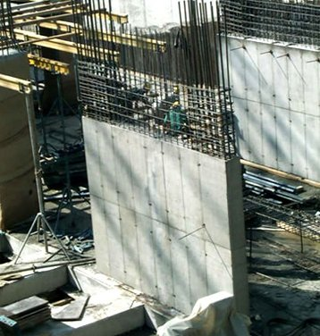
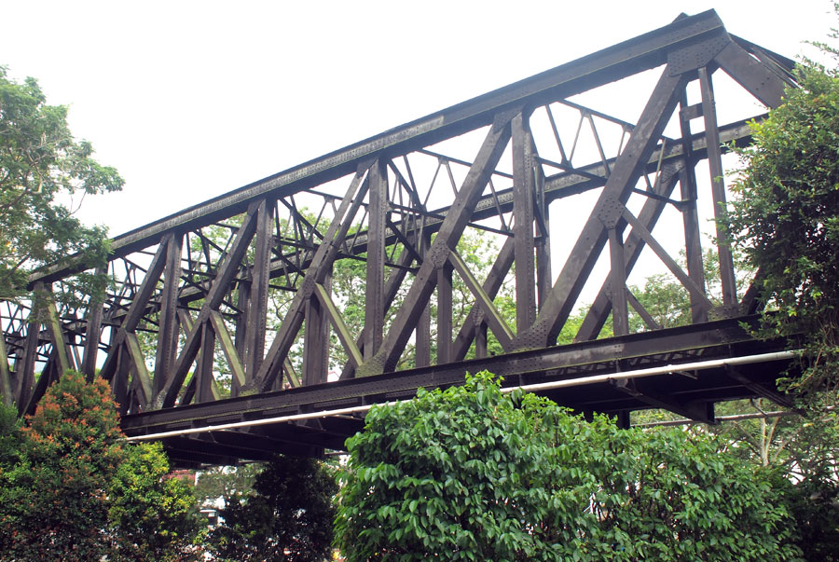
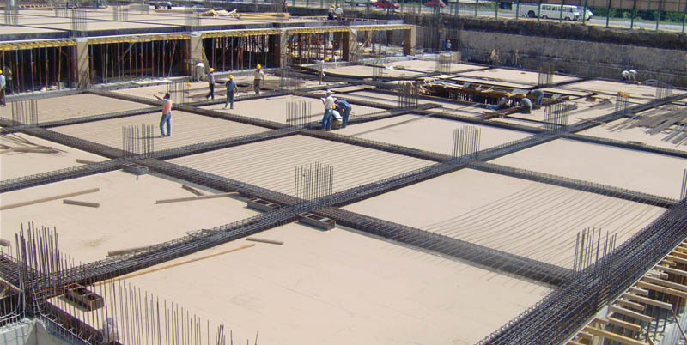
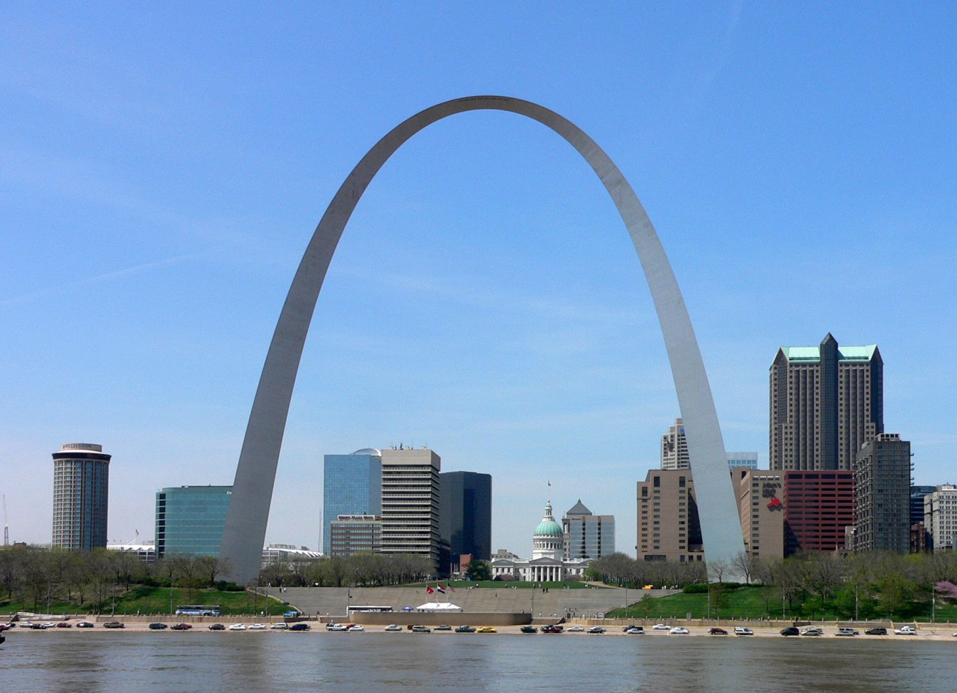
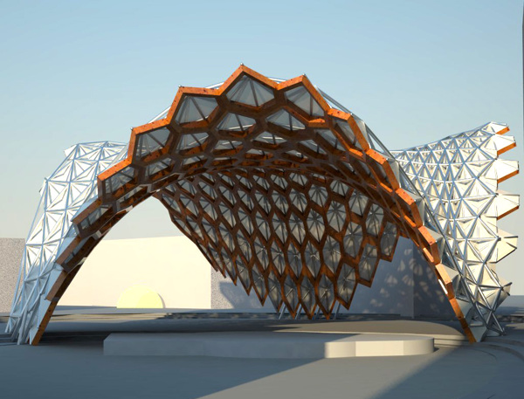
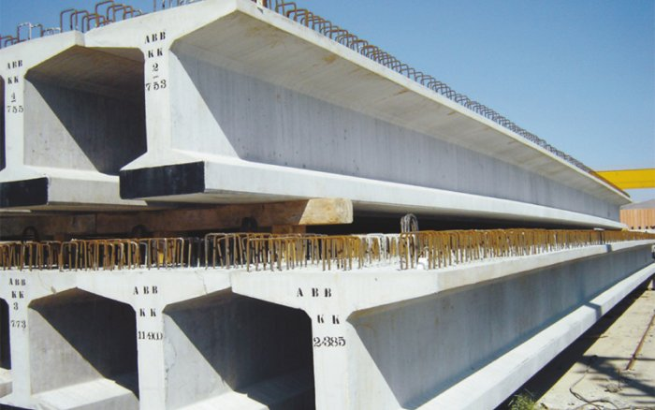
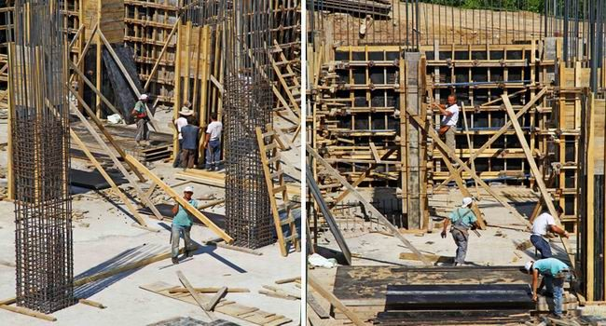
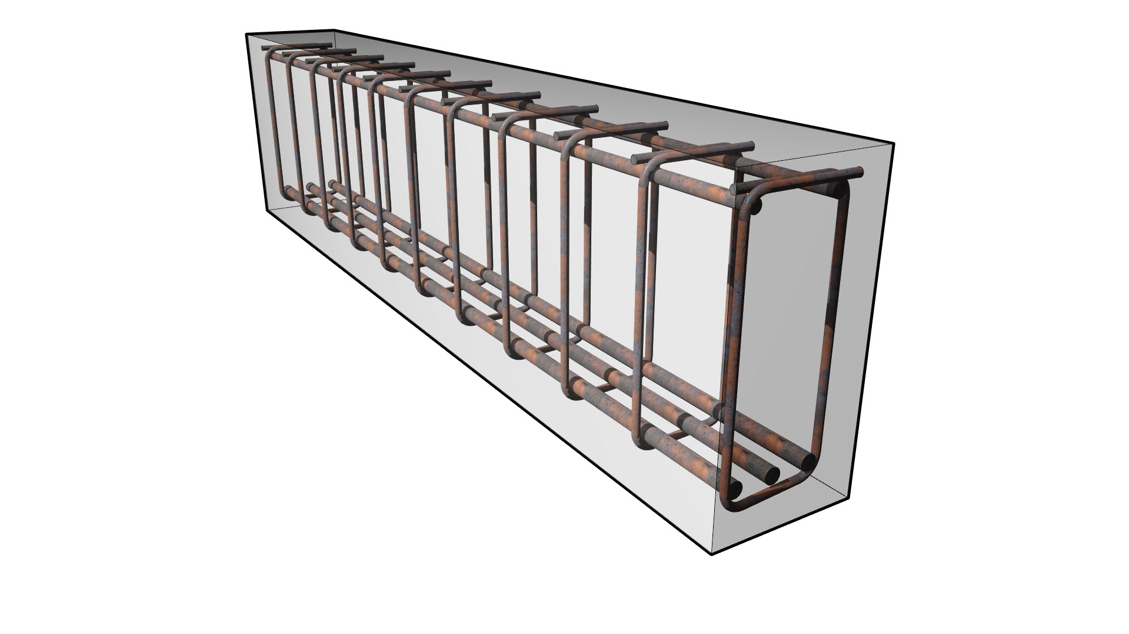
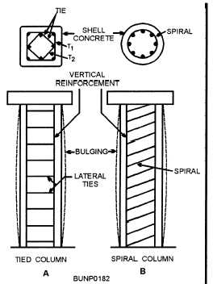
STRUCTURAL ELEMENTS
Columns
Beams
Slabs
Shearwalls
Trusses
Arches
Shells
MSKU Civil Engineering Department

Slide 14
DESIGN CODES AND STANDARDS
Structural Concrete Design=TS500
Structural Steel Design=TS648
Masonry=TS2510
Loads=TS498
Turkish Earthquake Code=TDY2007
ASTM,ASCE,ACI,AISC,Eurocode,IBC,AASHTO
MSKU Civil Engineering Department

Slide 15
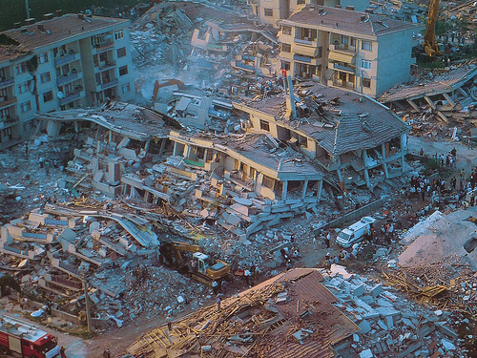
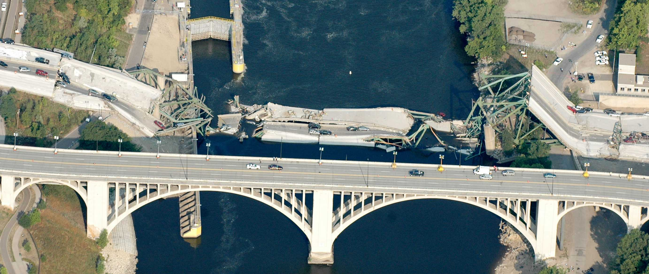
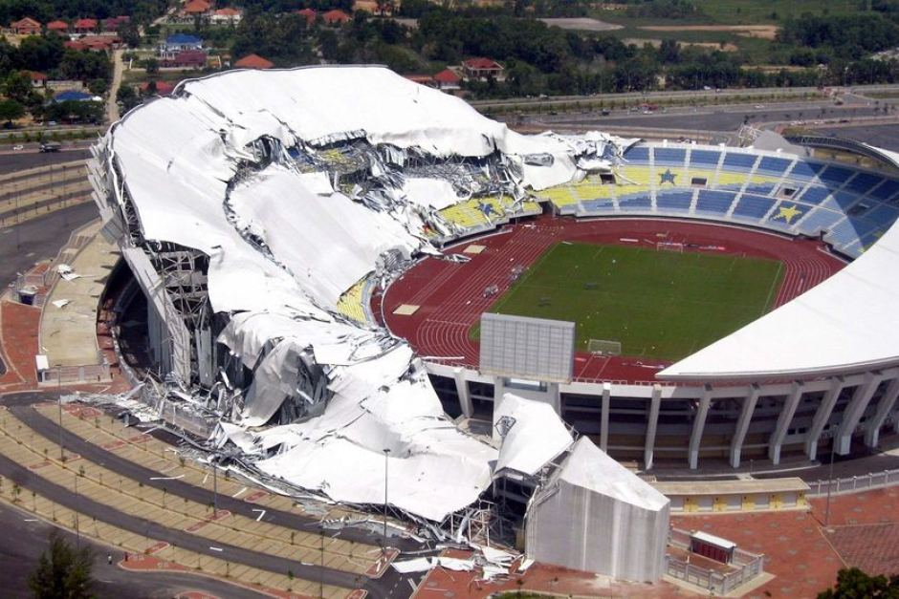
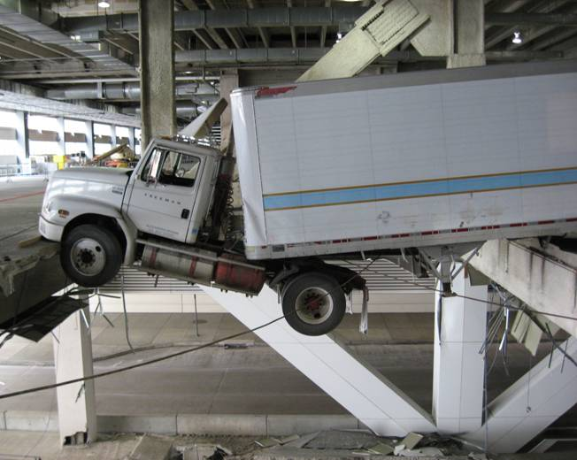
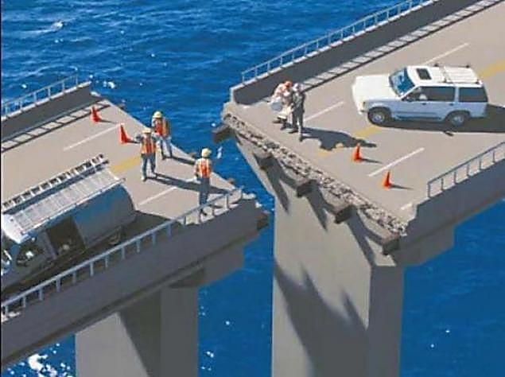
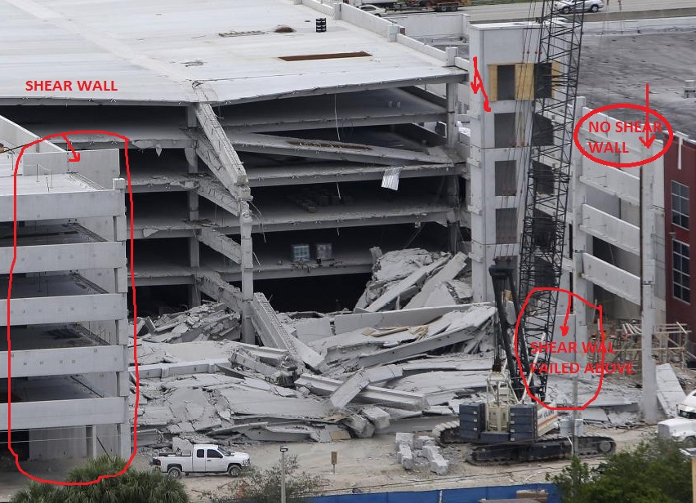
STRUCTURAL FAILURES
MSKU Civil Engineering Department

Slide 16
FINAL WORDS
Be Creative
Be Careful
Be Responsible
Be Economical
Remember,Time matters!!!
And Remember,Safety always comes first!!!
MSKU Civil Engineering Department

Slide 17
STRUCTURE COURSES
Structural Systems 1-2
Reinforced Concrete 1-2
Int. Structural Dynamics
Fundamental of Steel Design
Int. Finite Element Methods
Advanced Structural Analysis
Design of Tall Buildings
Computer App. in Structural Engineering
MSKU Civil Engineering Department

Slide 18
THANK YOU!
MSKU Civil Engineering Department

